Slide 1
CARMEN CUADRADO BRIONES
STATISTICS PREWORK
DATA ANALYTICS (APRIL 2020)

Slide 2
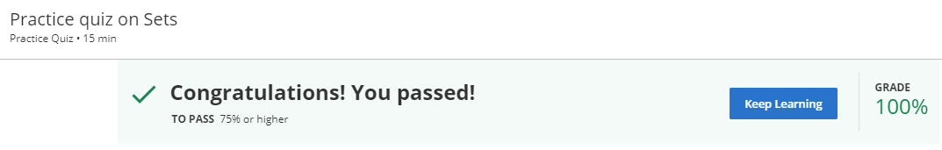
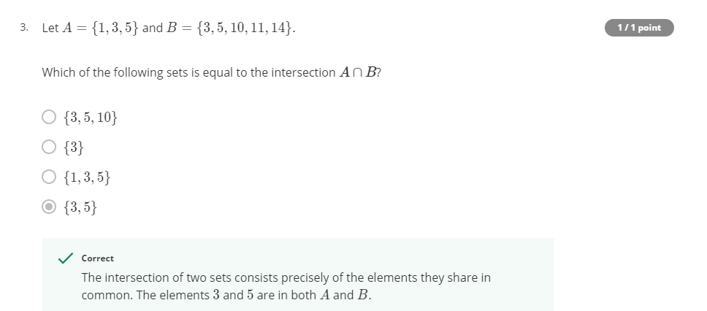
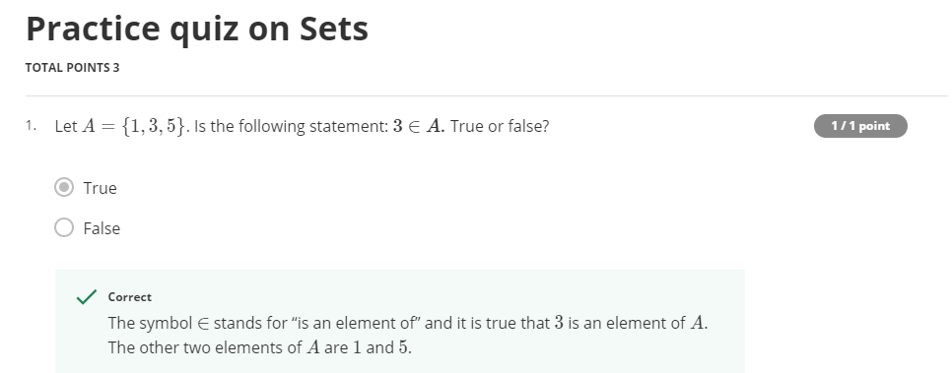
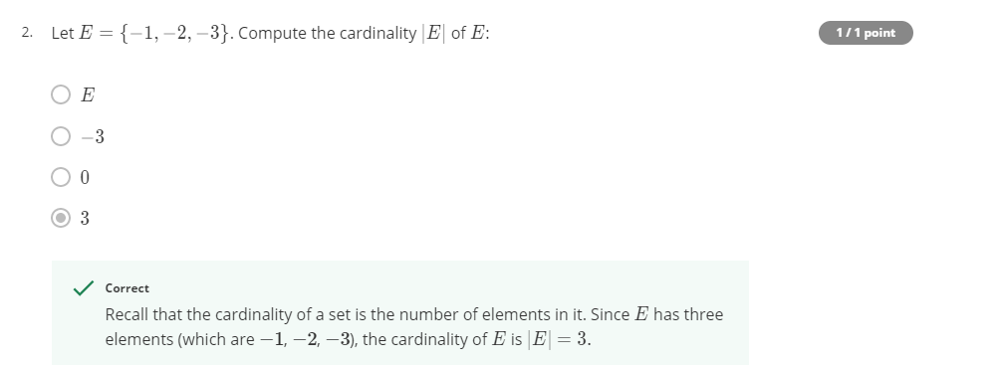
WEEK 1 – 1.Building Blocks for Problem Solving - Practice quiz on Sets (3 questions)

Slide 3
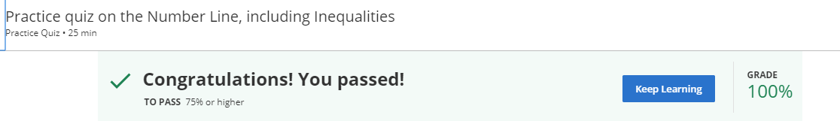
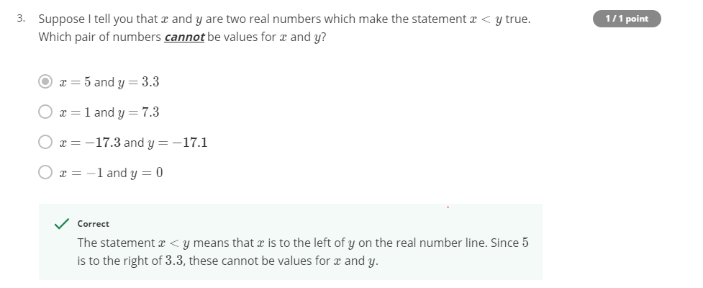
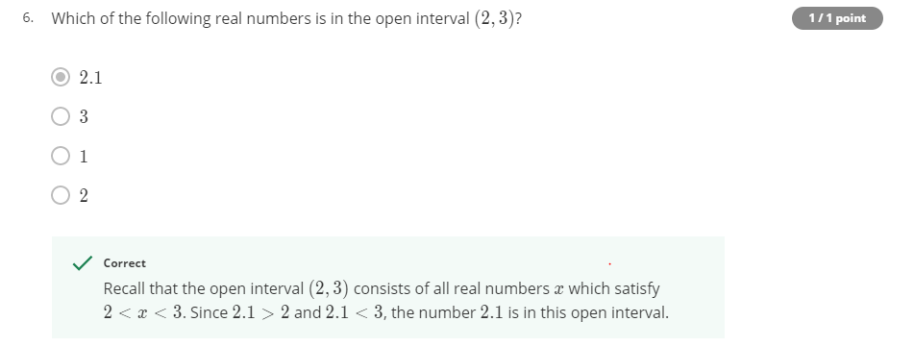
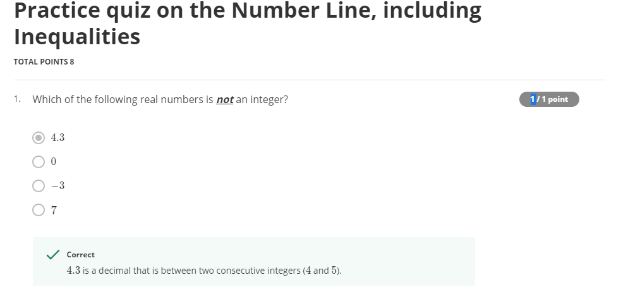
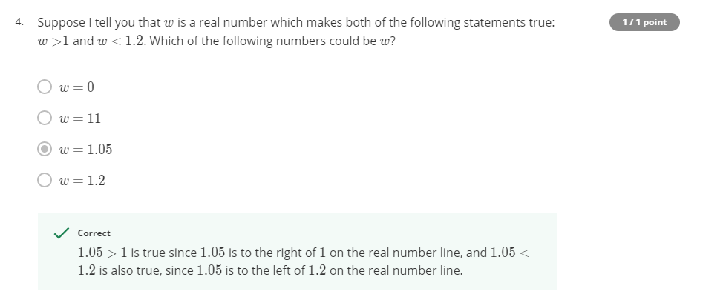
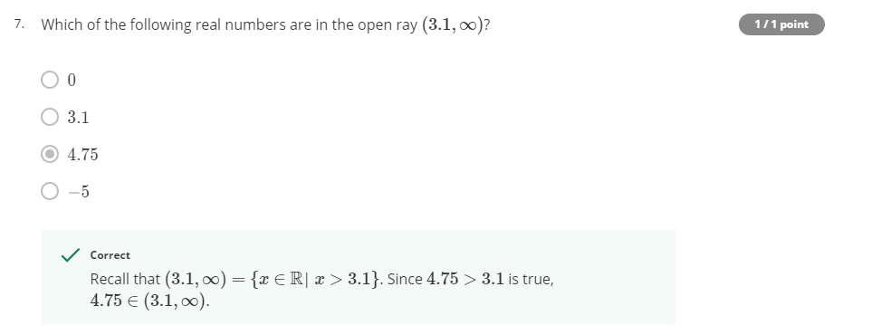
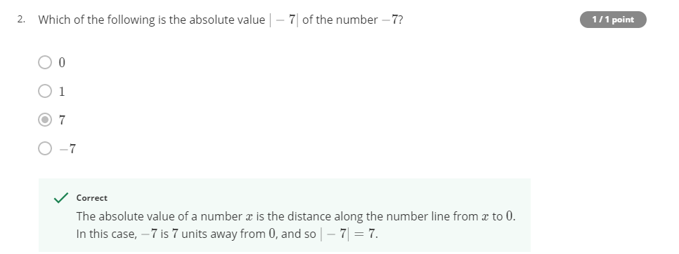
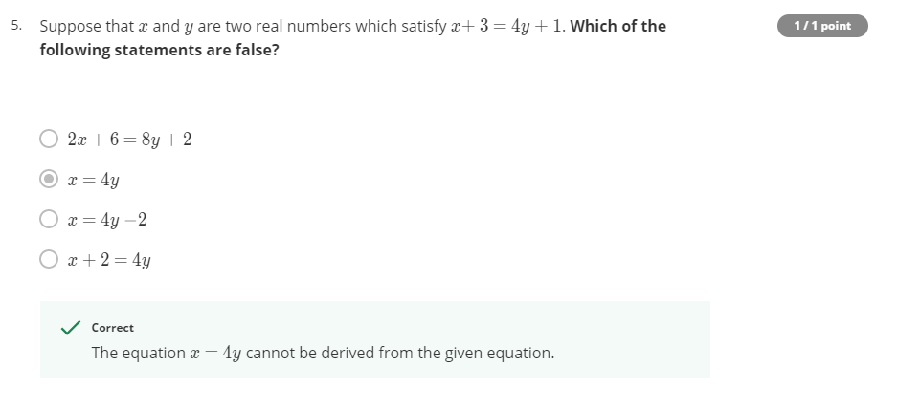
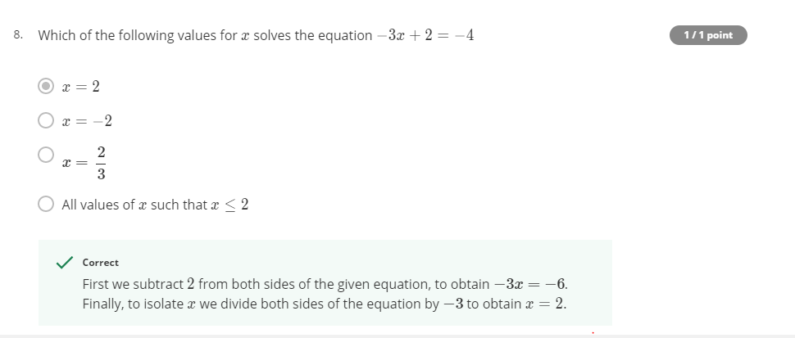
WEEK 1 – 2. The infinite World of Real Numbers - Practice quiz on the Number Line, including Inequalities (8 questions)

Slide 4
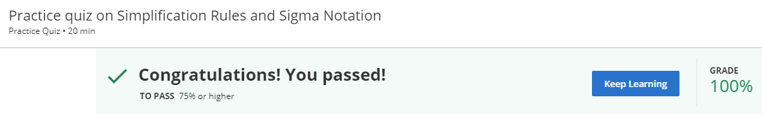
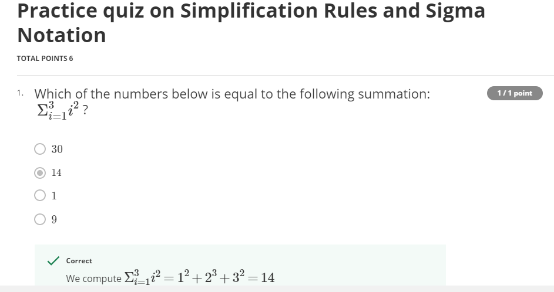
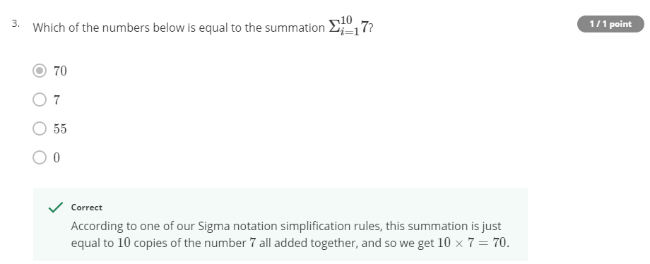
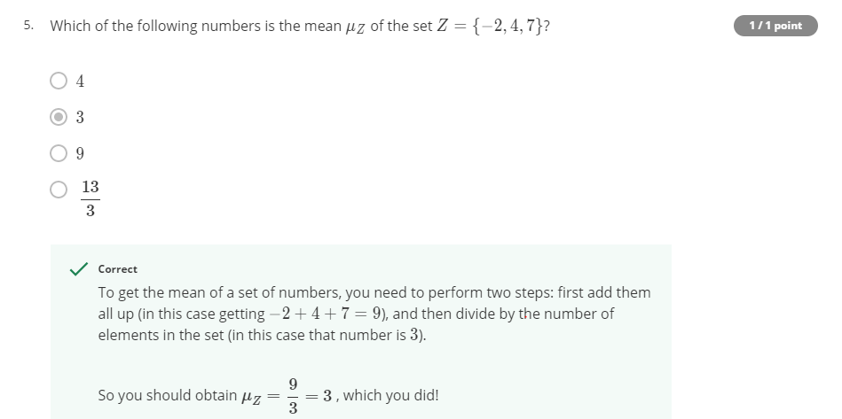
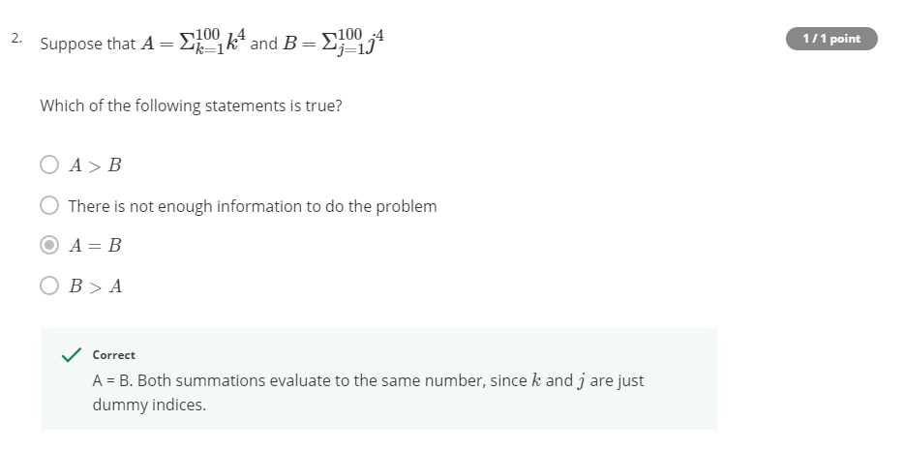
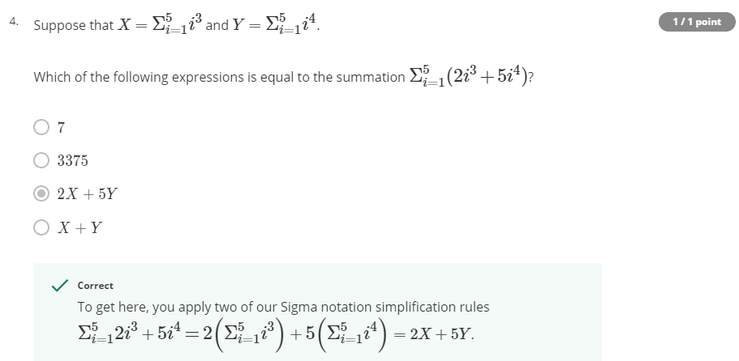
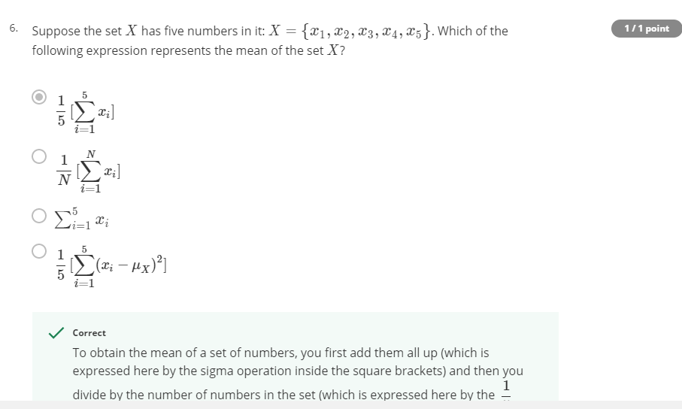
WEEK 1 – 3. That Jagged S Symbol - Practice quiz on Simplification Rules and Sigma Notation (6 questions)

Slide 5
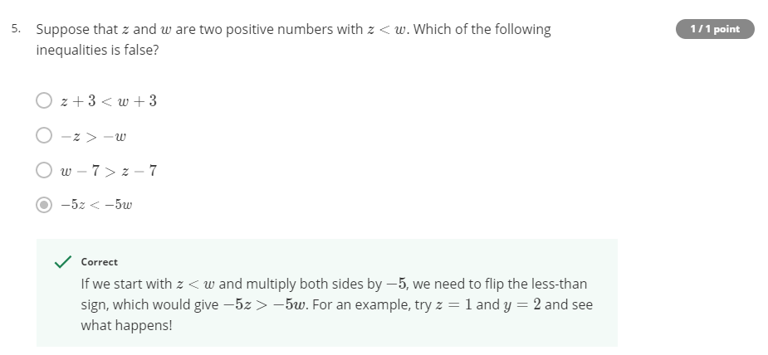
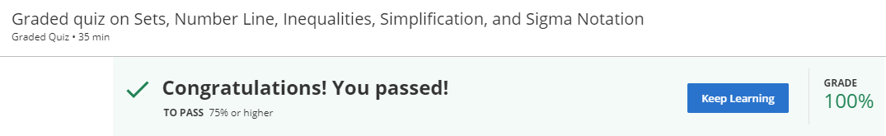
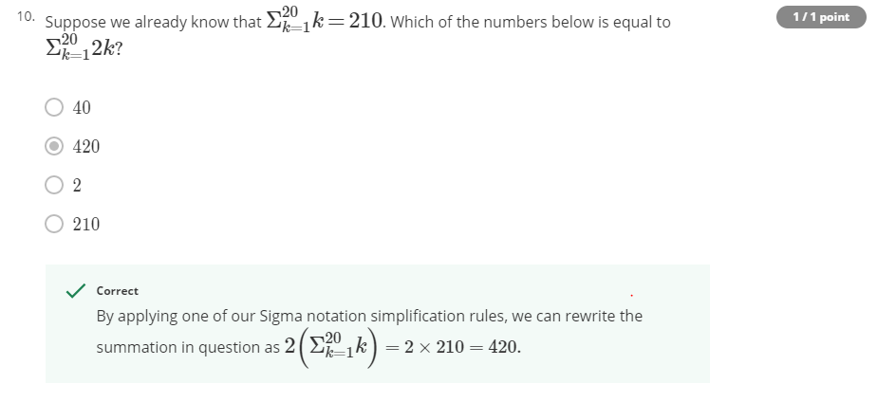
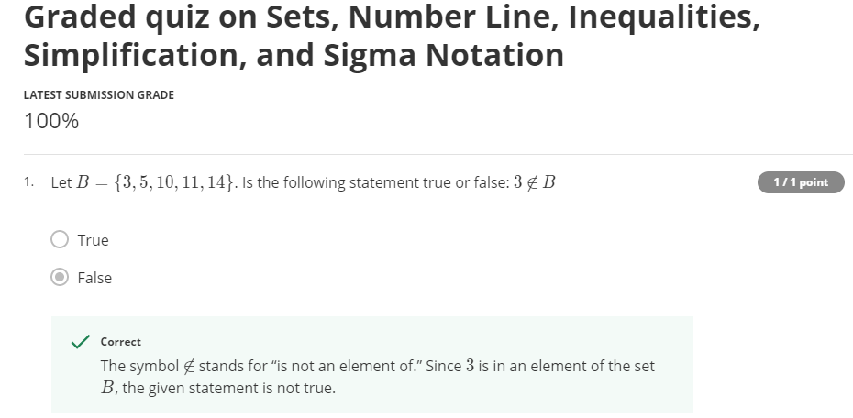
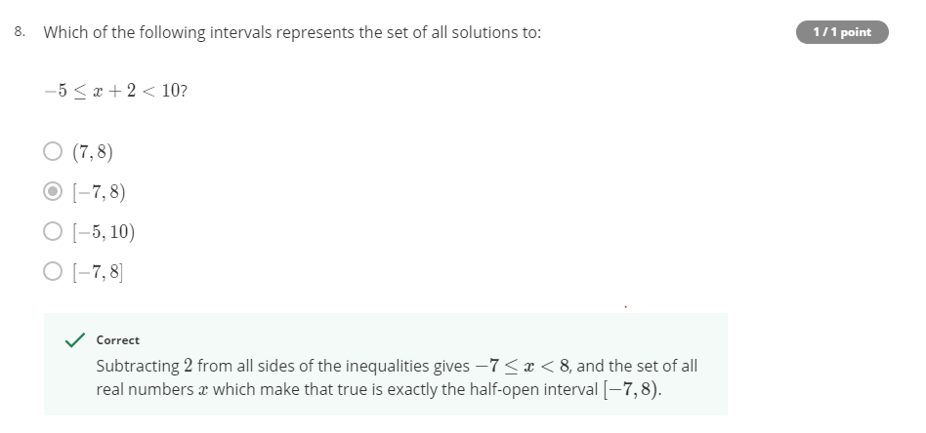
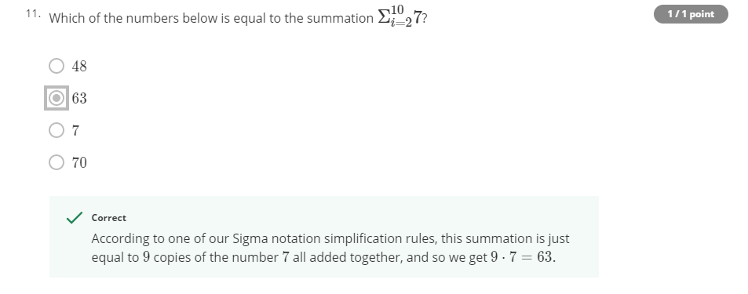
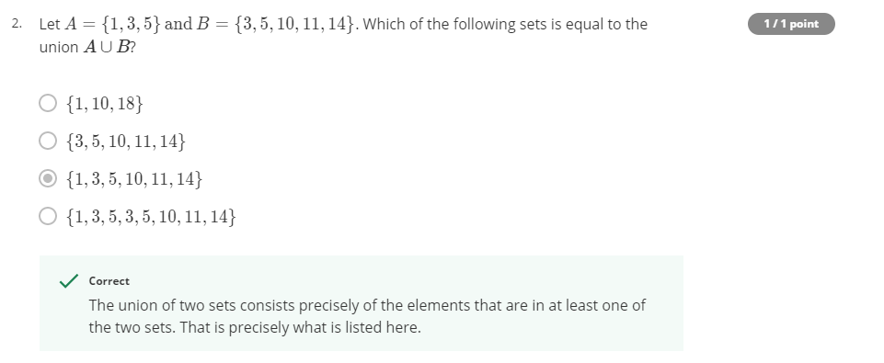
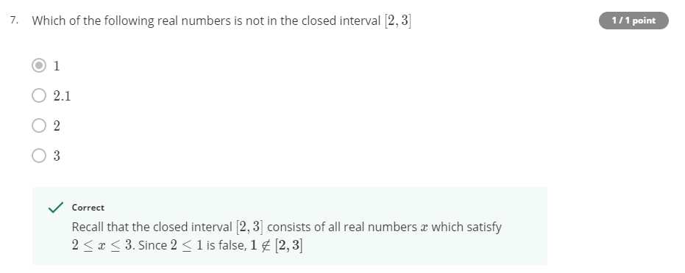
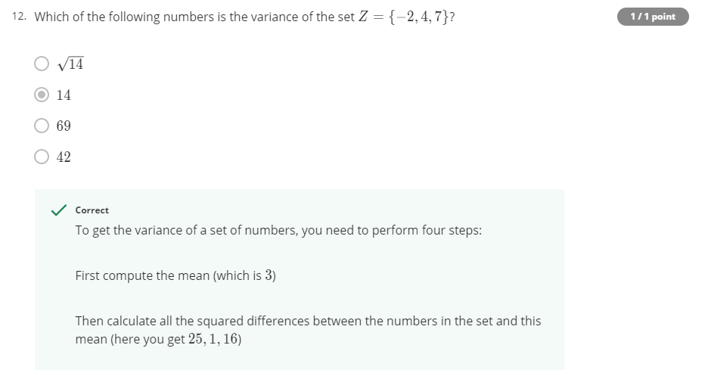
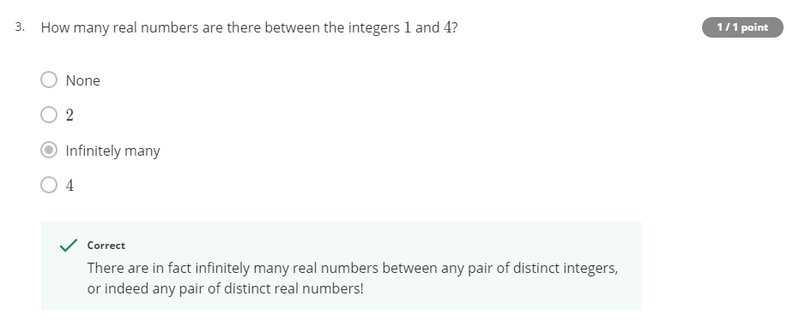
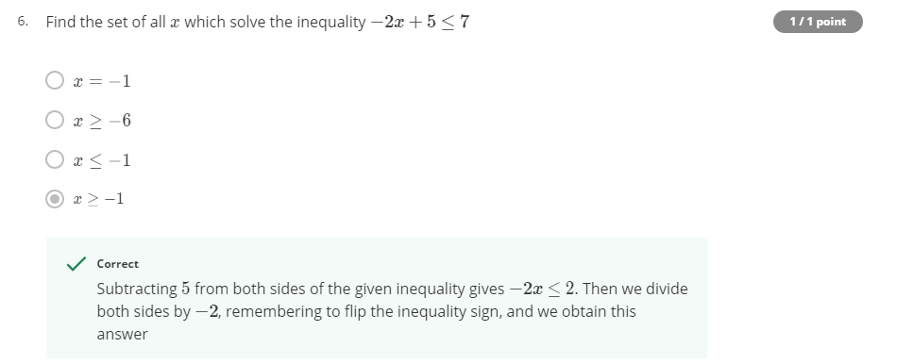
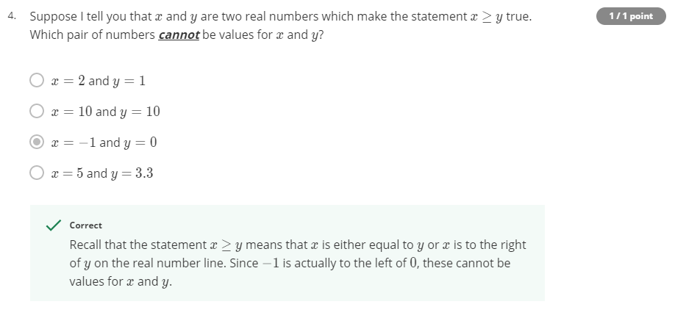
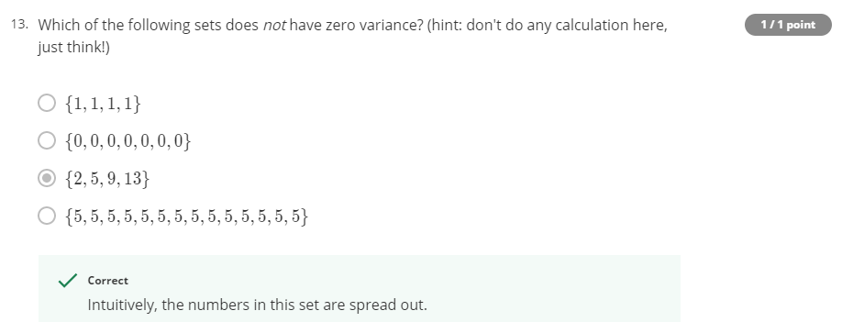
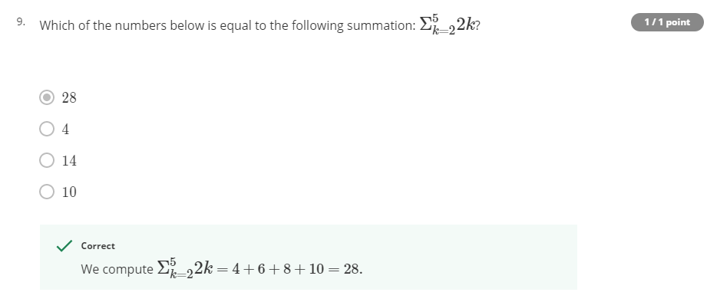
WEEK 1 – 4. That Jagged S Symbol - Graded quiz on Sets, Number Line, Inequalities, Simplification, and Sigma Notation (13 questions)

Slide 6
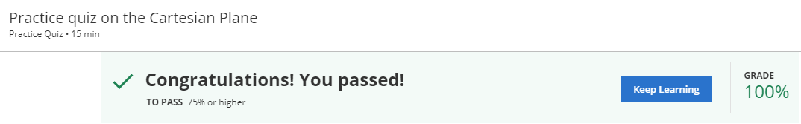
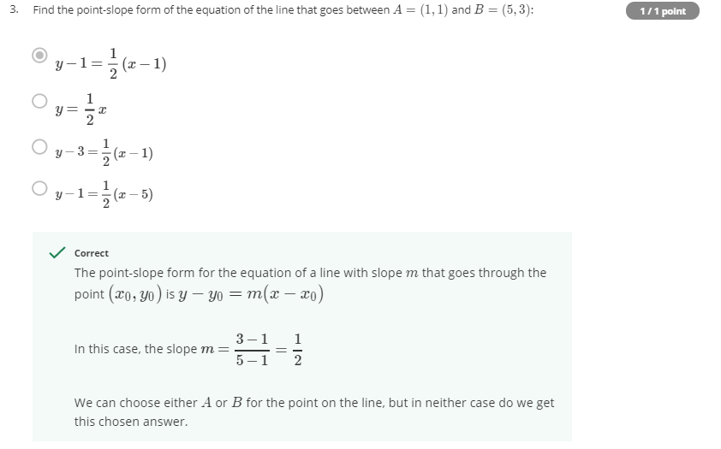
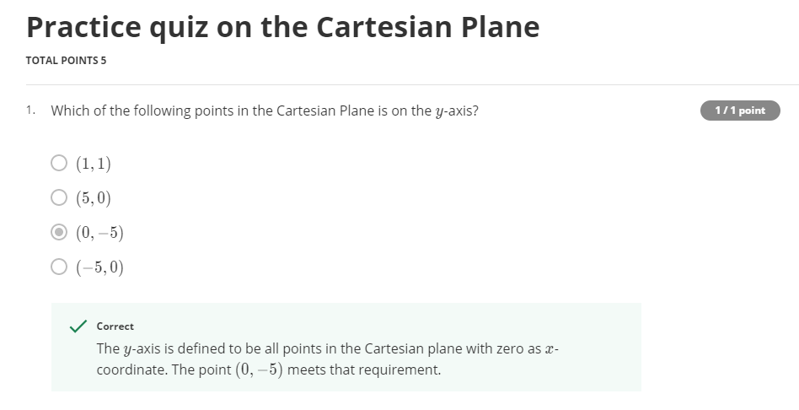
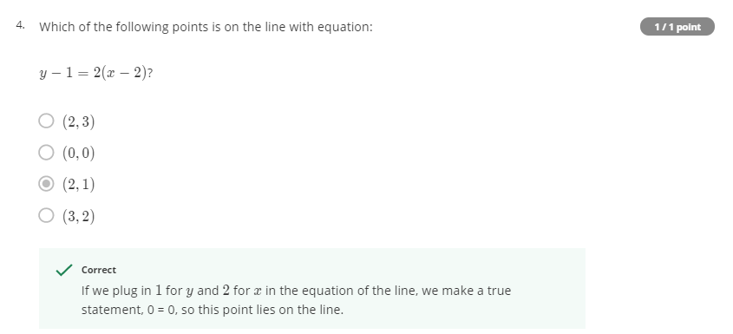
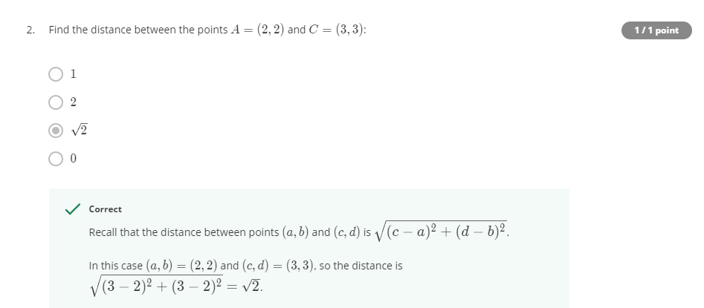
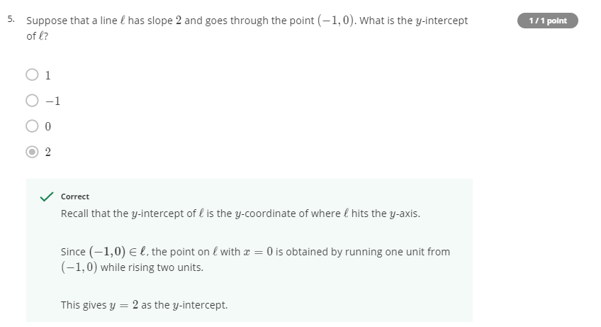
WEEK 2 – 1. Descartes Was Really Smart - Practice quiz on the Cartesian Plane (5 questions)

Slide 7
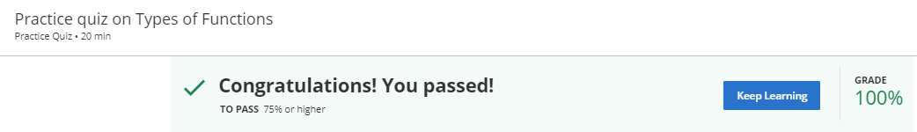
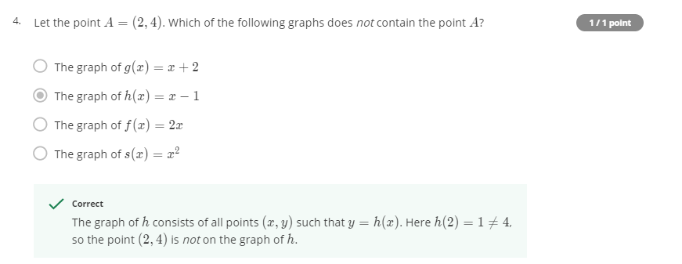
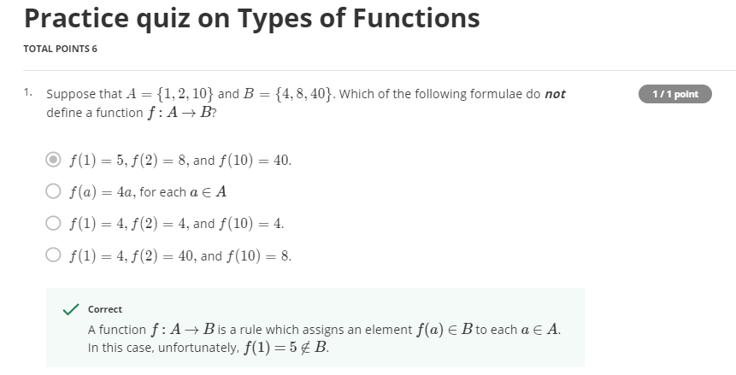
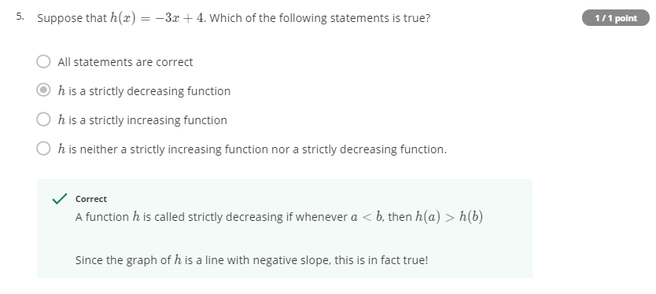
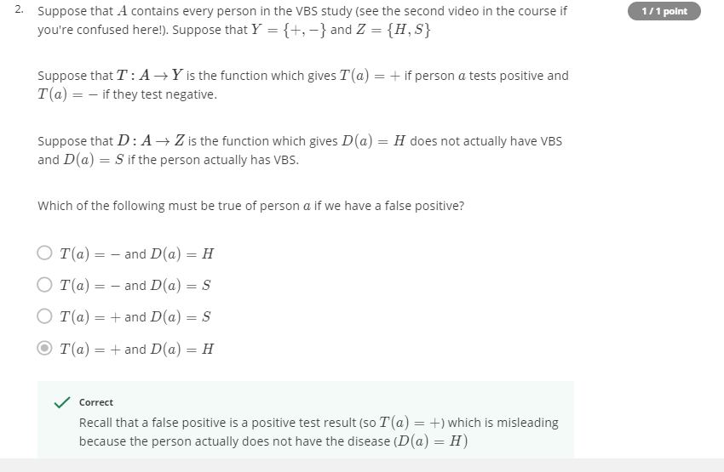
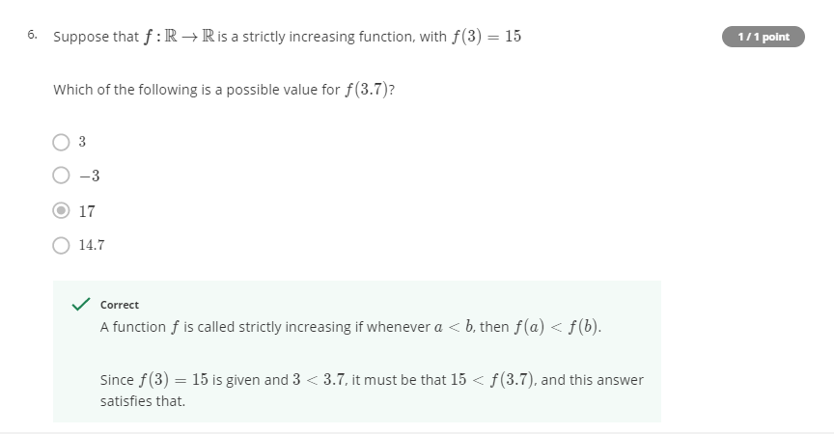
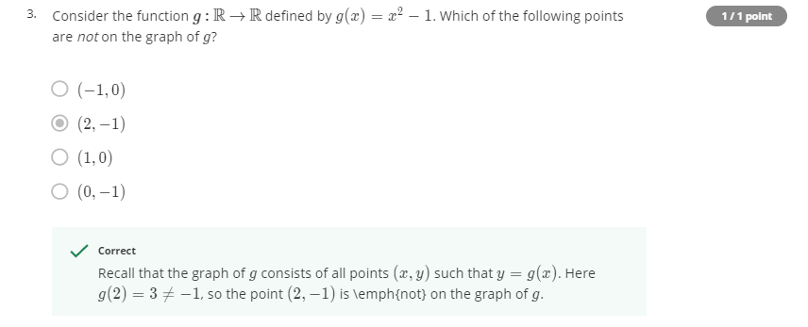
WEEK 2 – 2. Input-Output Machines - Practice quiz on Types of Functions (6 questions)

Slide 8
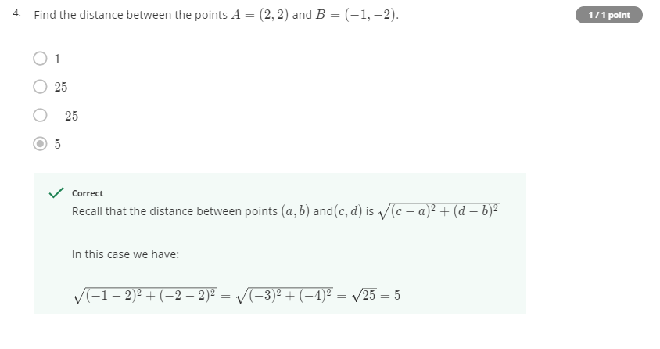
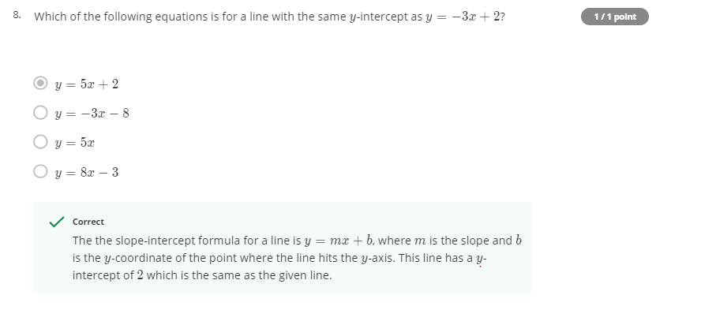
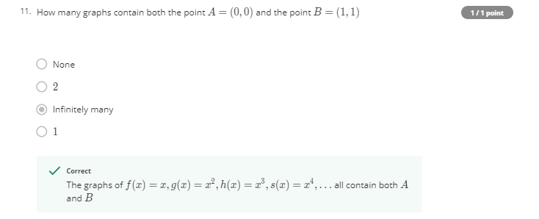











WEEK 2 – 3. Input-Output Machines - Graded quiz on Cartesian Plane and Types of Function (13 questions)

Slide 9



WEEK 3 – 1. This is about that derivative stuff - Practice quiz on Tangent Lines to Functions (2 questions)

Slide 10












WEEK 3 – 2. Fast Growth, Slow Growth - Practice quiz on Exponents and Logarithms (12 questions)

Slide 11












WEEK 3 – 3. Fast Growth, Slow Growth - Graded quiz on Tangent Lines to Functions, Exponents and Logarithms (13 questions)

Slide 12







WEEK 4 – 1. Basic Probability Definitions - Practice quiz on Probability Concepts (9 questions)

Slide 13









WEEK 4 – 2. Problem Solving Methods - Practice quiz on Problem Solving (9 questions)

Slide 14












WEEK 4 – 3. Applying Bayes Theorem and the Binomial Theorem - Practice quiz on Bayes Theorem and the Binomial Theorem (9 questions)

Slide 15








WEEK 4 – 4. Applying Bayes Theorem and the Binomial Theorem - Probability (basic and Intermediate) Graded Quiz (12 questions)

